Slide 1

SAMPLE ONLY
Position of a Point in a Plane
Ch 3: How do you describe the position of the photo-frame on the wall to another person?
Notes:
Say: In today’s session, lets learn how to describe the position of a point in a 2-d plane. For example, you want to describe the position of the photo-frame fixed on the wall to the another person, then you can find the position of the position of the points in the 2-d plane?

Slide 2
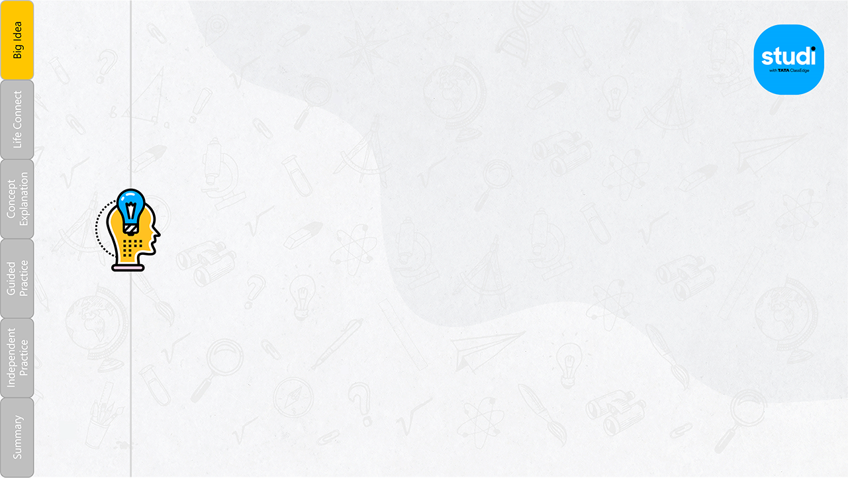

How do we locate points?
Notes:
Say: We all must have gone to the movie to the theatre. We must have seen the seat numbers printed in the tickets with one alphabet and one number. How do we locate the seats in the theatre.
Ask: Do you know how to find your seat?
<Collect responses>
Say: Let’s find out how to locate the points.
<Show the Big Idea Video ‘How do we locate points?’ Only from Studi (Full Video)>
<Pause, Mute, Speak and Explain using the video>

Slide 3


ECG taken on a coordinate plane
Notes:
Ask: What does this image depict?
<Collect Responses>
Say: This is the image of an ECG taken to check the heart beat of a person.
Can you see it taken on a graph?
The horizontal and vertical coordinates tells us whether our heart beat is normal or not.

Slide 4

How to find the location of a place?
Notes:
Ask: What are the white criss-cross lines on a map?
<Collect Responses>
Say: The criss cross lines are the imaginary lines on a map.
They are called latitudes and longitudes.
The horizontal line is the latitude and the vertical line shows the longitude.
They are just graphs with coordinates latitude as the x-axis and longitude as the y – axis.
The latitudes and longitudes determine the location of a place.
Ask: Do you know the location of your place? Try to locate it from the map.
<Collect Responses?

Slide 5




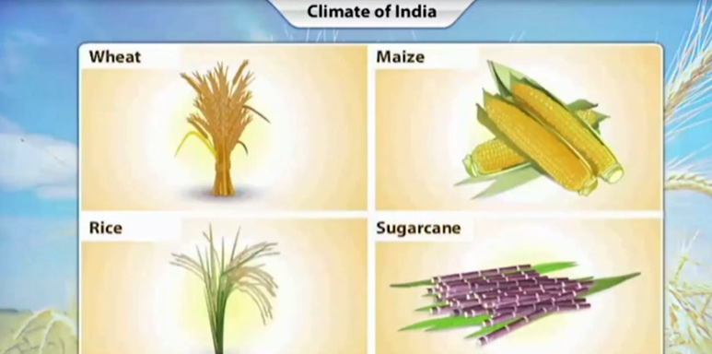
How can we describe the position of a photo-frame on a wall to another person?
Remember
What are the cropping patterns in India?
Life Connect
Concept Explanation
Guided Practice
Independent Practice
Summary
Notes:
Ask: Let’s now explore more about graphs.
Do you know what is a 2-dimensional plane?
<Collect Responses>
Say: A 2-dimensional plane has only two axes: one in the vertical direction and the other in the horizontal direction.
The horizontal direction is called the x- axis and the vertical direction is called the y-axis.
Say: Let’s see the video and understand more on how to find the position of the photo frame on a wall.
<Show the Video ‘’How can we describe the position of a photo-frame on a wall to another person?’
Only from Studi (Full Video)>
<Pause, Mute, Speak and Explain using the video>

Slide 6


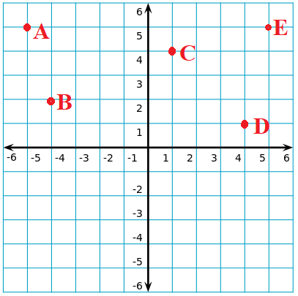
Remember
Recap
Lets Answer:
Life Connect
Find the coordinates of the point A, C and E.
Hook
Concept Explanation
Main Concept
Guided Practice
Guided Practice
Independent Practice
Independent Practice
Summary
Summary
Notes:
Now we know what are the coordinates in the 2-dimensional p lane.
Let’s answer some questions to understand more about the locating points on a plane.
Ask: Find the co-ordinates of the points: A, C and E.
<Collect responses and explain>
Say:
We should find the co-ordinate x an y first.
Let’s see point A. The x axis is -5 and the y axis is 5
So, the co-ordinate is (-5,5)
Then point C. The x axis is 1 and y axis is 4.
So, the coordinate is (1,4)
Then point E. The x-axis is 5 and the y-axis is 5.
So, the coordinate is (5,5)

Slide 7
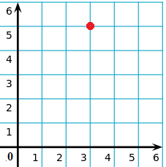
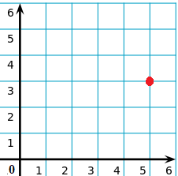
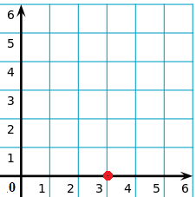
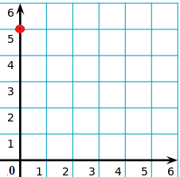
Remember
Recap
Lets Answer:
Life Connect
Find the coordinates of the point according to the given location.
Point F is located 3 units to the right and 5 units above the origin.
Hook
Concept Explanation
Main Concept
F
F
Guided Practice
Guided Practice
F
Independent Practice
Independent Practice
F
(a)
(b)
(c)
(d)
Summary
Summary
Notes:
Ask: Find the coordinates of the point according to the given location.
Point F is located 3 units to the right and 5 units above the origin.
<Collect responses and explain>
Say: c) Social issues. It affects a major part of our population which is a reason for poor health in humans.

Slide 8
Remember
Recap
Lets Answer:
Life Connect
Hook
How many axis (axes) are necessary to describe the position of photo frame on the wall?
1
2
3
4
Concept Explanation
Main Concept
Guided Practice
Guided Practice
Independent Practice
Independent Practice
Summary
Summary
Notes:
Ask: How many axis (axes) are necessary to describe the position of photo frame on the wall?
<Collect responses and explain>
Say: That’s correct. We need two axes, that is x-axis and y-axis to describe the position of photo frame on the wall.

Slide 9

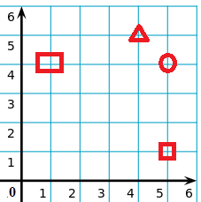
Remember
You Solve.
Recap
Life Connect
Hook
1. Which shape is located in the point (4,5) on the grid?
Concept Explanation
Main Concept
Guided Practice
Guided Practice
Independent Practice
Independent Practice
Summary
Summary
Notes:
<Let them solve and share their answers.>
Answer: Triangle lies in the coordinate (4,5)

Slide 10
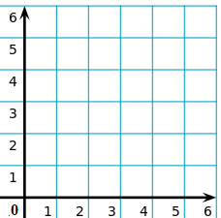
Remember
You Answer.
Life Connect
2. A car was parked at (1, 2) on the grid. Draw the location of the parking of the car in the given grid.
Concept Explanation
Guided Practice
Independent Practice
Summary
Notes:
<Let them solve and share their answers.>

Slide 11
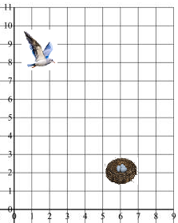
Remember
You Answer.
Life Connect
3. Which coordinate should the bird go to reach its nest?
Concept Explanation
Guided Practice
Independent Practice
Summary
Notes:
<Let them solve and share their answers.>
Answer: The nest is in coordinate (6,2)

Slide 12

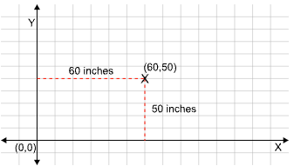
Remember
You Answer.
Summary:
Life Connect
We use two lines. the perpendicular (y-axis) and the horizontal (x-axis), by considering the wall as a two-dimensional plane to describe the position of a photo frame on the wall.
Example:
Here, the position of the photo frame is indicated by the cross symbol ()
The distance of the cross symbol () from the x-axis and the y-axis should be calculated as x and y respectively. We can then write the position of the photo frame in terms of the coordinates as (x, y).
The distance of the point from the x-axis is 50 inches and from the y-axis is 60 inches.
So, the photo frame is at point (60, 50).
7. Define what is sowing?
Concept Explanation
Guided Practice
Independent Practice
Summary
Notes:
<Here is what we have learnt>

Slide 13

Practice:
Which of the following is the correct method to plot the point (4, 12)?
Right 4, up 12
Left 4, up 12
Left 4, down 12
Right 4, up 12
Notes:
<Practice more questions from the “Studi” app>

